Slide 1

Exploratory Data Analysis
Name: XYZ
Location : Dubai,UAE
Team : Data And Analytics
Date : 11-March-2021

Slide 2
Agenda
Executive Summary
Data Processing
Making Hypothesis
EDA
EDA Summary
Recommendations

Slide 3
Executive Summary
XYZ, an American private company, plans to invest in Cab industry since it is growing up remarkably.
The Analysis has been divided into 5 parts: - Data Processing - Generating 8 hypothesis - EDA & EdA Analysis - Summary - Suggestions
Opportunity

Slide 4
Data Processing
6 Data files : Cab_data, City, Customer_ID, Transanction_ID, weather data, advisorsmith_cost_of_living _index
12 Useful Variables : Transaction ID, Date of Travel, Company, City, KM Travelled, Price charged, Cost of Trip, Population, Users, Customer ID, Payment Mode, Weather Type, Cost of Living
Processing : Combining necessary files and variables for each hypothesis

Slide 5
Data Processing
Assumptions - Users in “City.csv”data assumes as users only use for XYZ company for Cab service. - Profit is calculated by ‘Price_charged-Cost_of_Trip’ for each trip. - Income is divided in 3 classes which are “high”, “middle” and “low”. - Precipitation mostly consists of rain, snow, hail so the number of precipitation’s are distributed to number of rain, snow, and and hail vectors by their ratio. - The weather type is determined based on the StartTime of the weather event.

Slide 6
8 Hypothesis
Do different age group and gender prefer certain type of the payment mode or company?
Does two company earn same profits by KM?
What is the relationship between income class and profit? Does it relevant?
Does the weather affect for customers to use cab services ?
Will profits of company increases in 2019?
Do customer in different cities have preference when choosing taxi company ?
Does the taxi fare reflects well the cost of living in each cities?
What about regular customers?

Slide 7
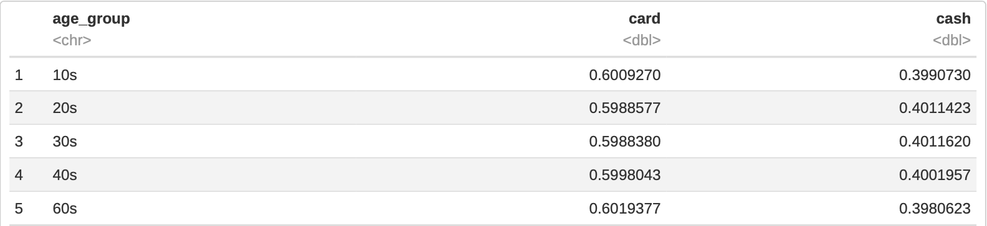
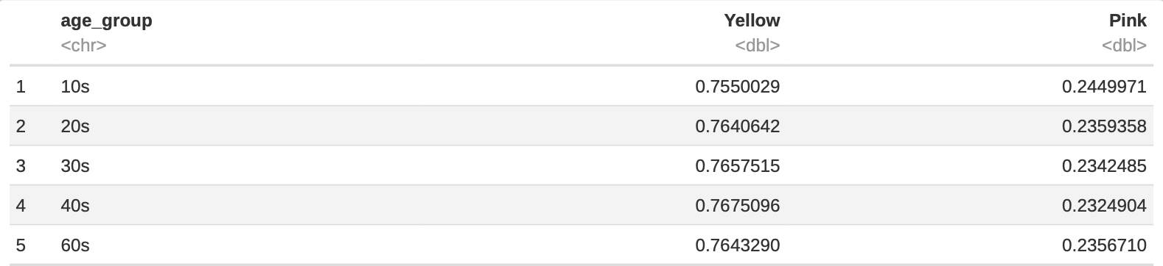
1.Age Group, Gender ~ Payment Mode, Company
Age Group ~ Payment Mode
Age Group ~ Company
- 60% of all age group prefers to pay by card and 40% of them like to pay by cash. - Around 76 % of all age group prefers Yellow Cab, while around 24% does Pink Cab.

Slide 8
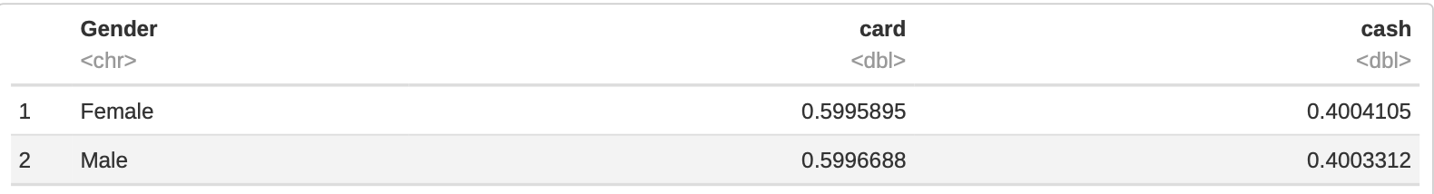
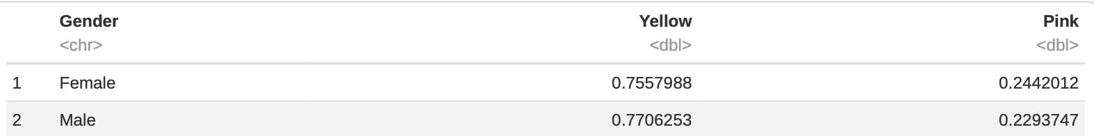
1.Age Group, Gender ~ Payment Mode, Company
Gender ~ Payment Mode
Gender ~ Company
- 60% of both gender prefers to pay by card and 40% of them like to pay by cash. - Around 76 % of men and women prefers Yellow Cab, while around 24% does Pink Cab.

Slide 9
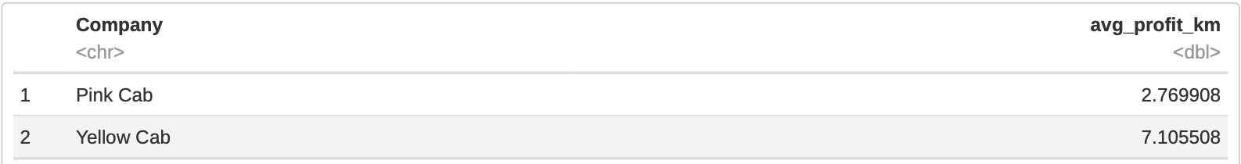
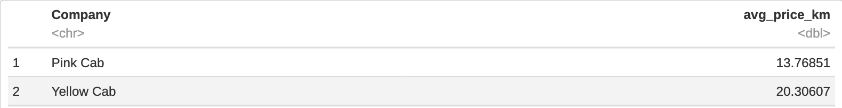
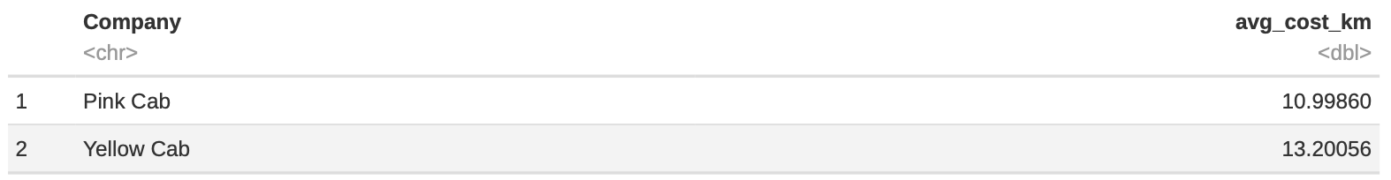
2. Profit by KM
Average profit by km
Average price by km
Average cost by km

Slide 10
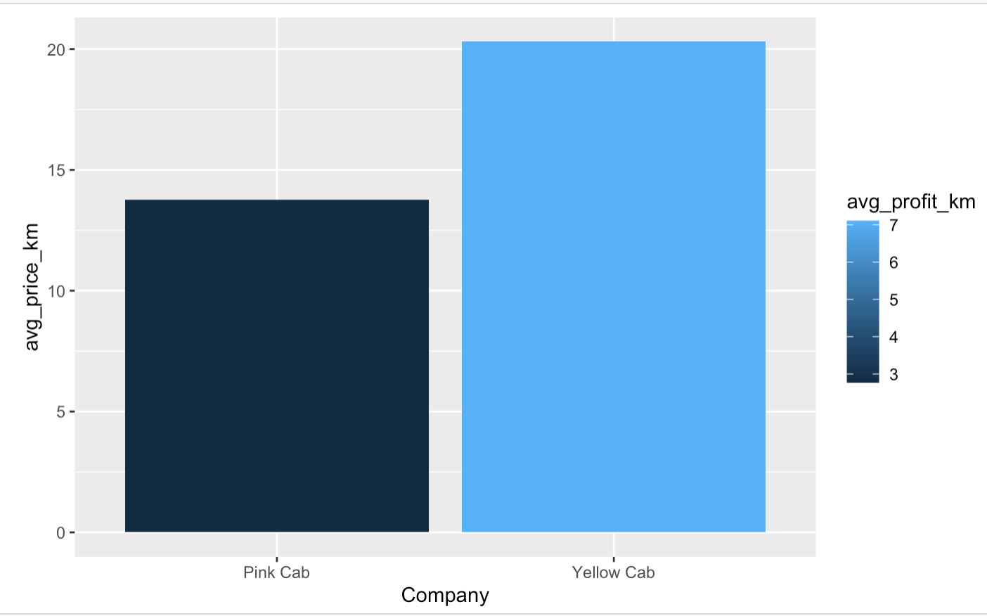
2. Profit by KM
Yellow Cab charges more by km than Pink cab.
Yellow Cab earns more profit for each km.

Slide 11
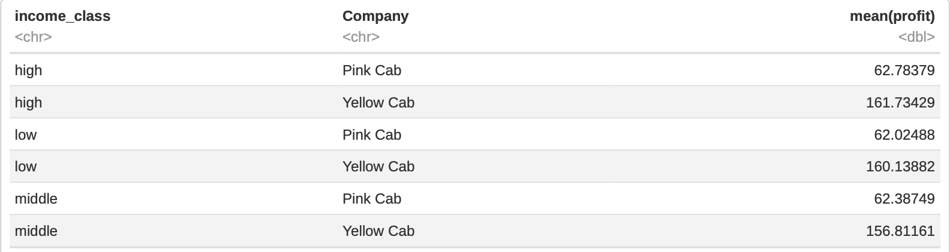
3. Income class ~ profit
- Average profit in all income class is around 62 for Pink Cab and about 161 for Yellow Cab which is around 3 times difference.

Slide 12
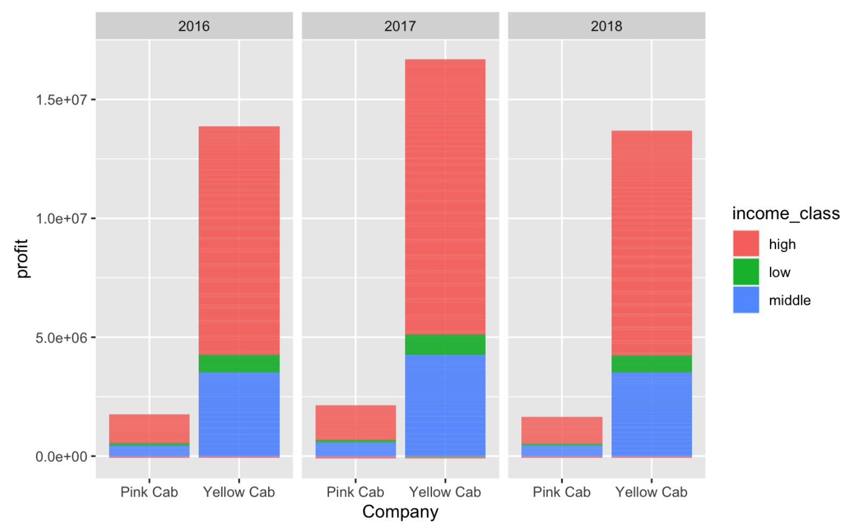
3. Income class ~ profit
- All income class brings averagely similar profits. But high class use taxi service the most followed by middle class and low class.

Slide 13
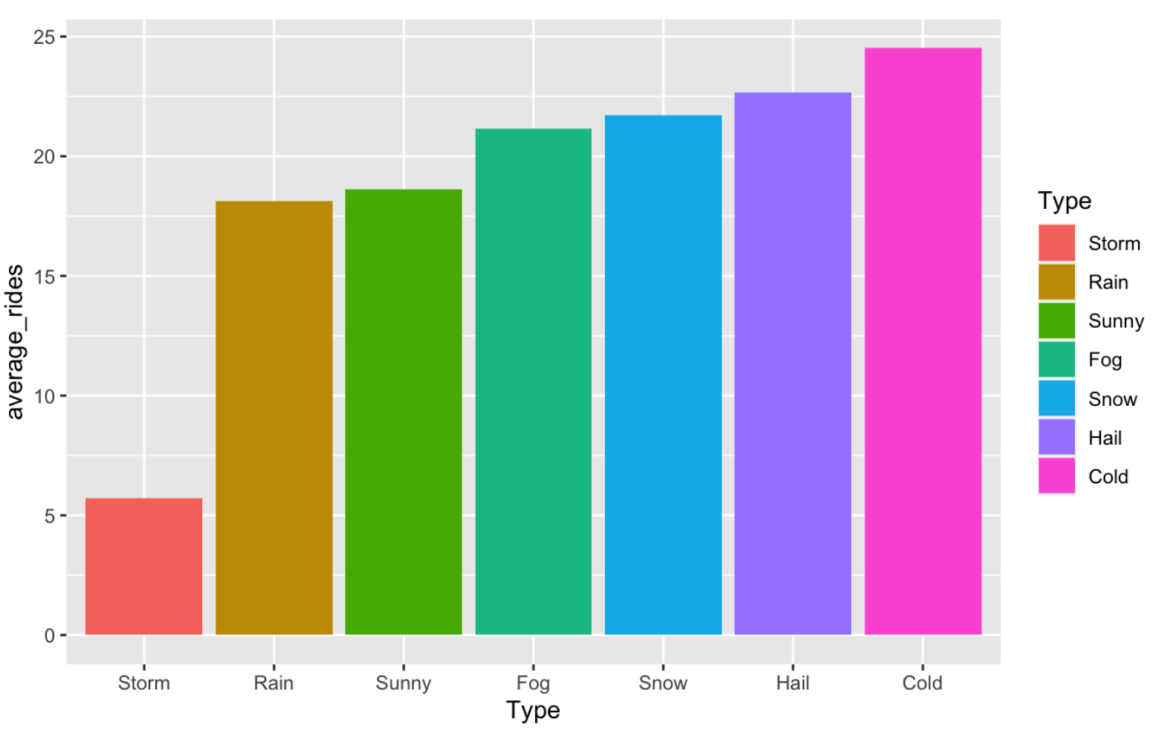
4. Weather factor
- The number of average rides per day are mostly higher than sunny days when there are weather events except storm.

Slide 14
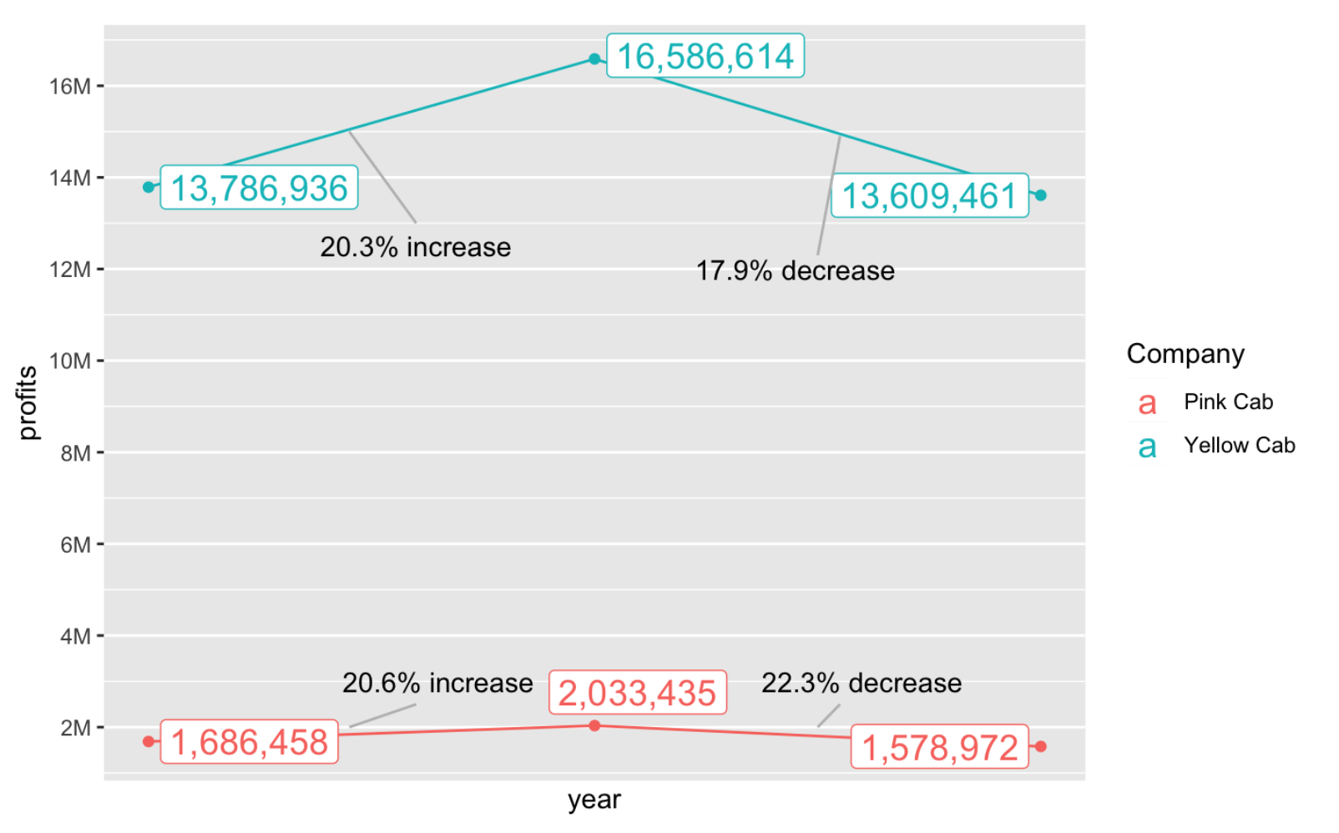
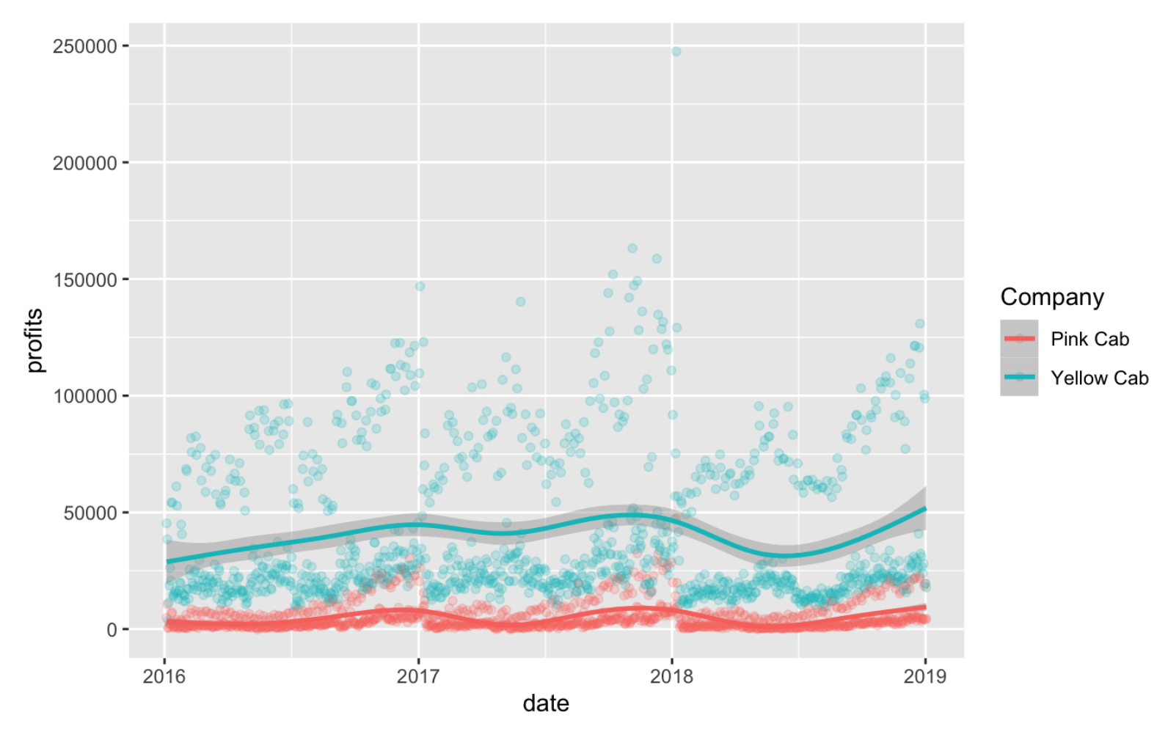
5. Trends of profit
- The profit of the company went up in 2017 but it went down in 2018 again as the same level in 2016.

Slide 15
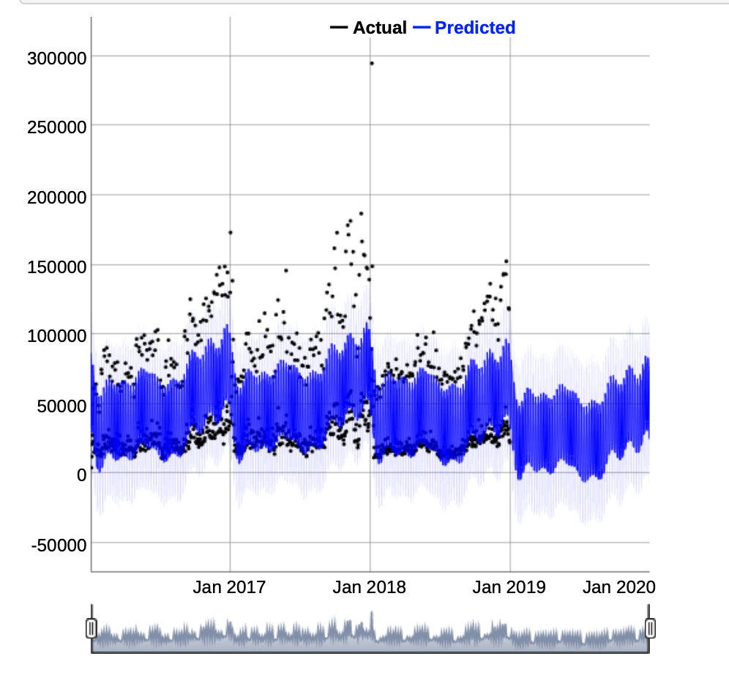
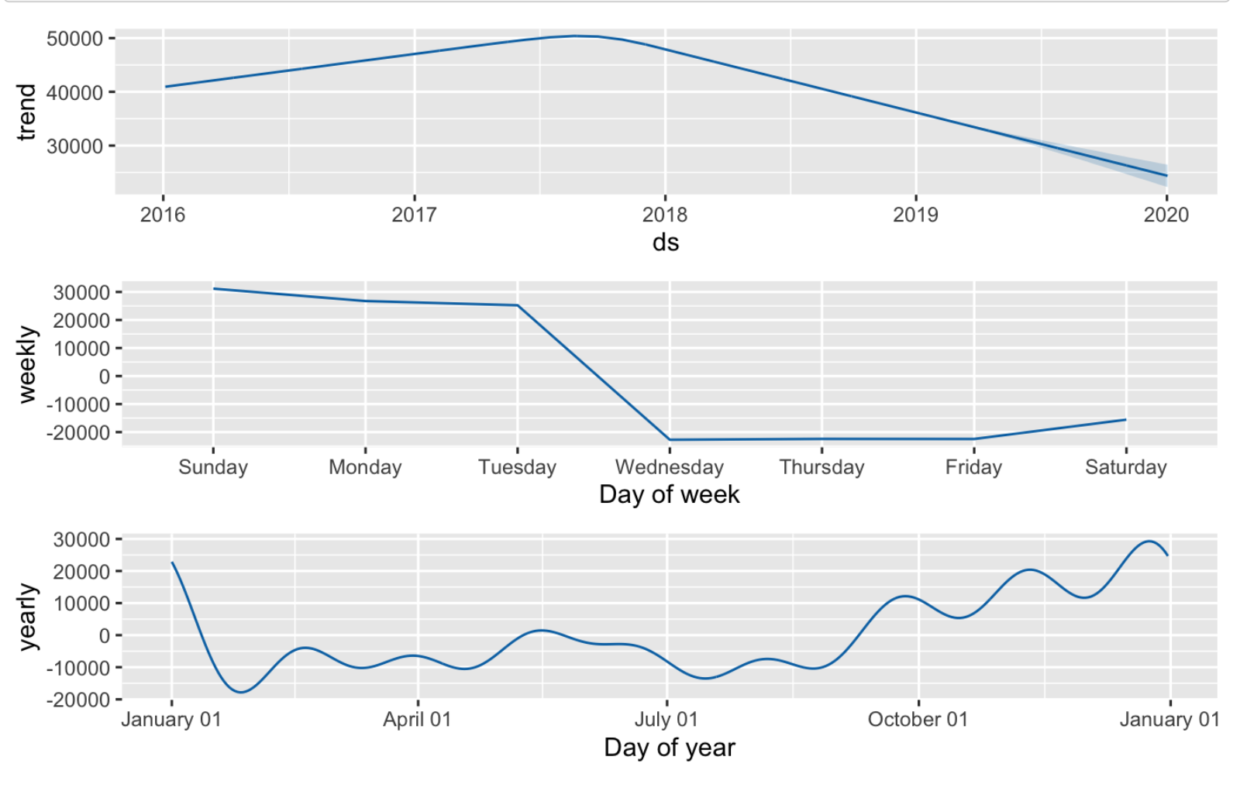
5. Trends of profit
The expected trend in 2019 is like above.
It seems like profit will decrease or even in a good therm in 2019 compared to 2018.

Slide 16
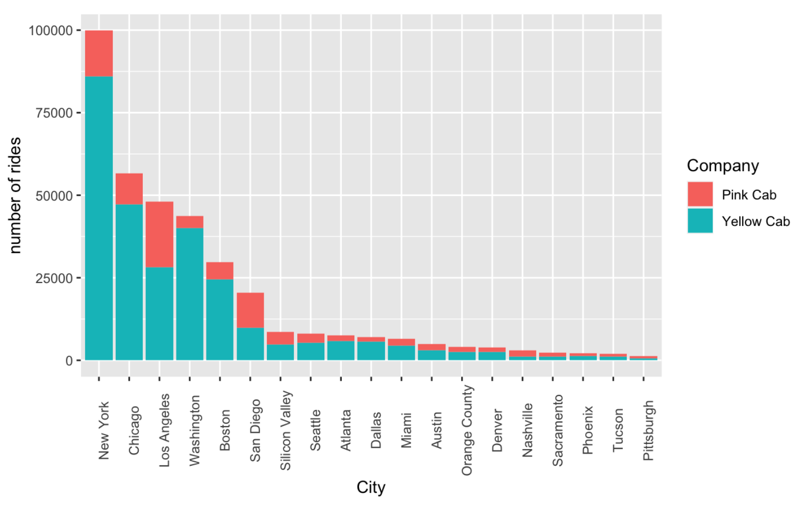
6. Preference in different cities
- The number of rides are the highest in New York and the lowest in Pittsburgh.

Slide 17
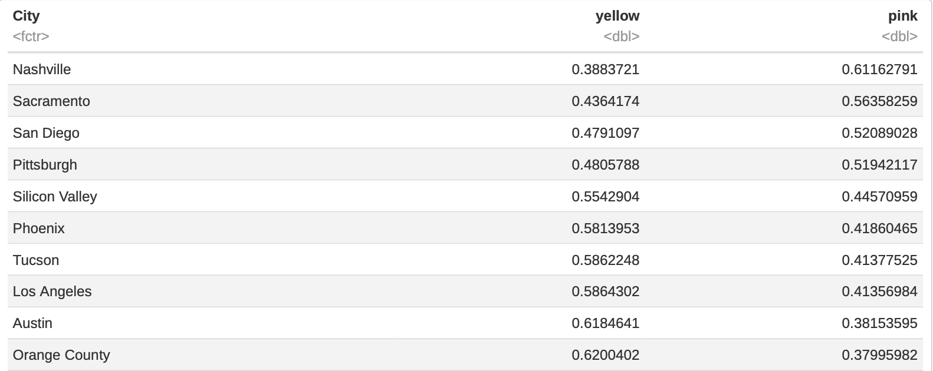
6. Preference in different cities
- All of cities’ citizens except Nashville, Sacramento, San Diego, Pittsburgh prefer to take Yellow cab than another.

Slide 18
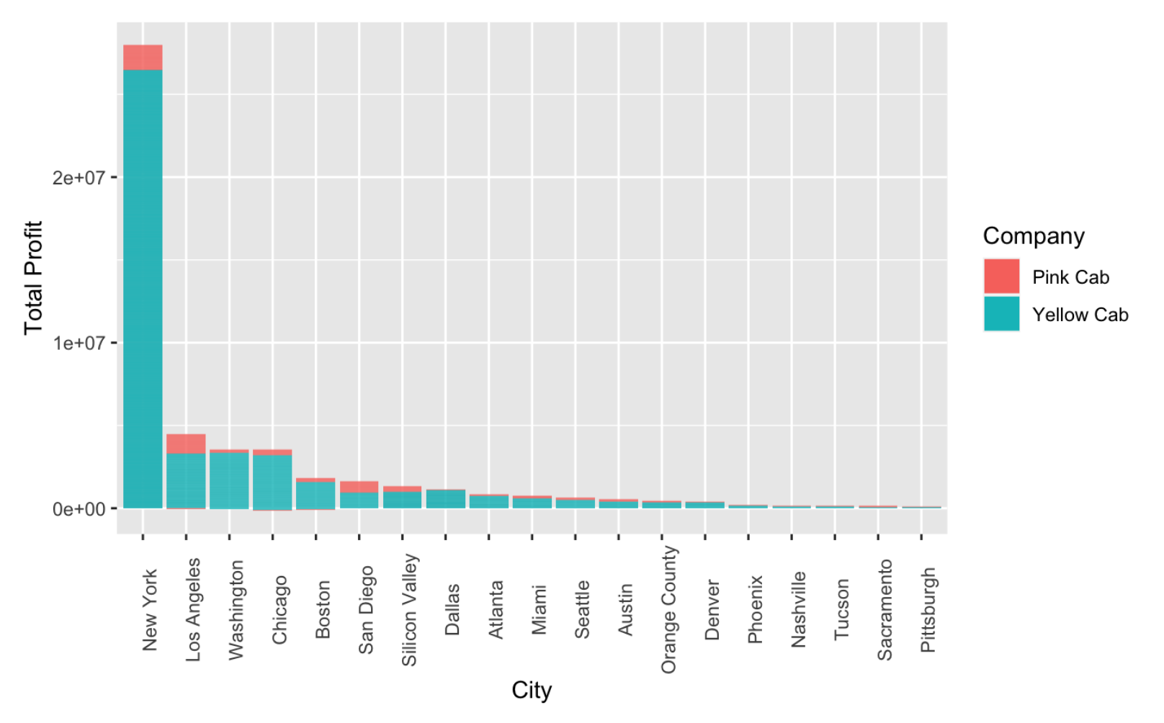
6. Preference in different cities
New York brings the most profit out of all cities by far.
Pittsburgh brings the least profit among the cities.
The 4 cities, Nashville, Sacramento, San Diego, Pittsburgh, which prefer Pink Cab than Yellow Cab bring not much profit.

Slide 19
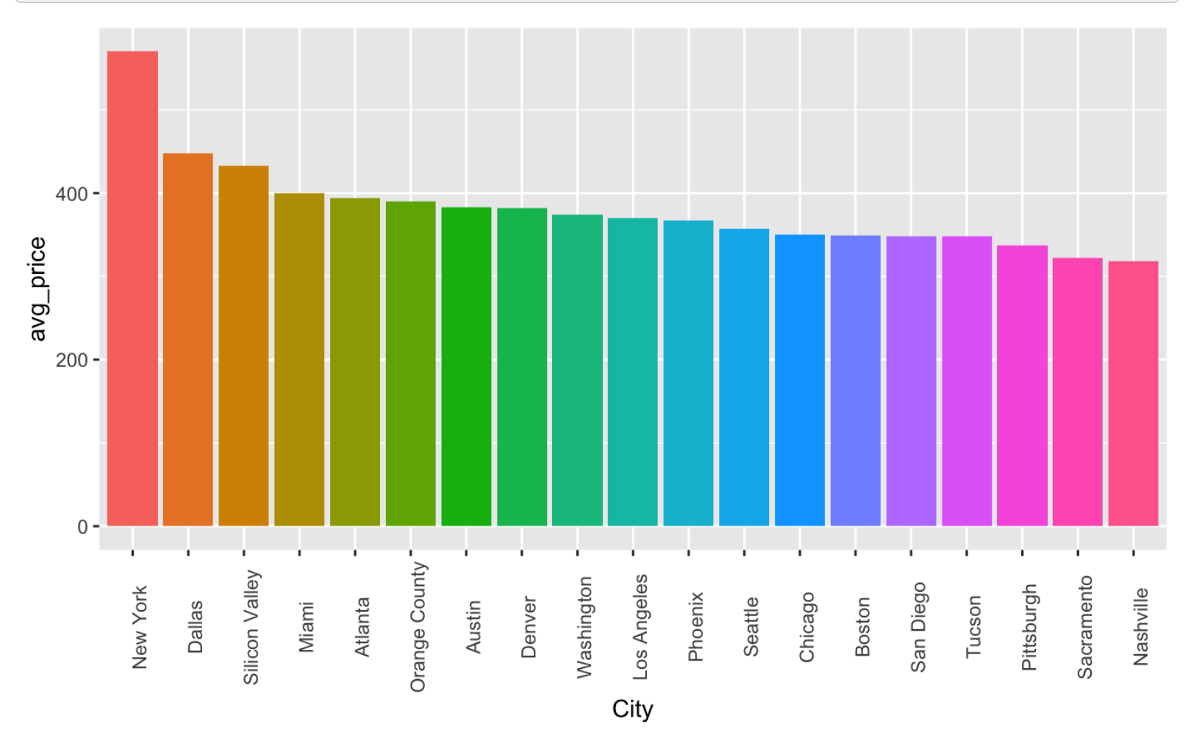
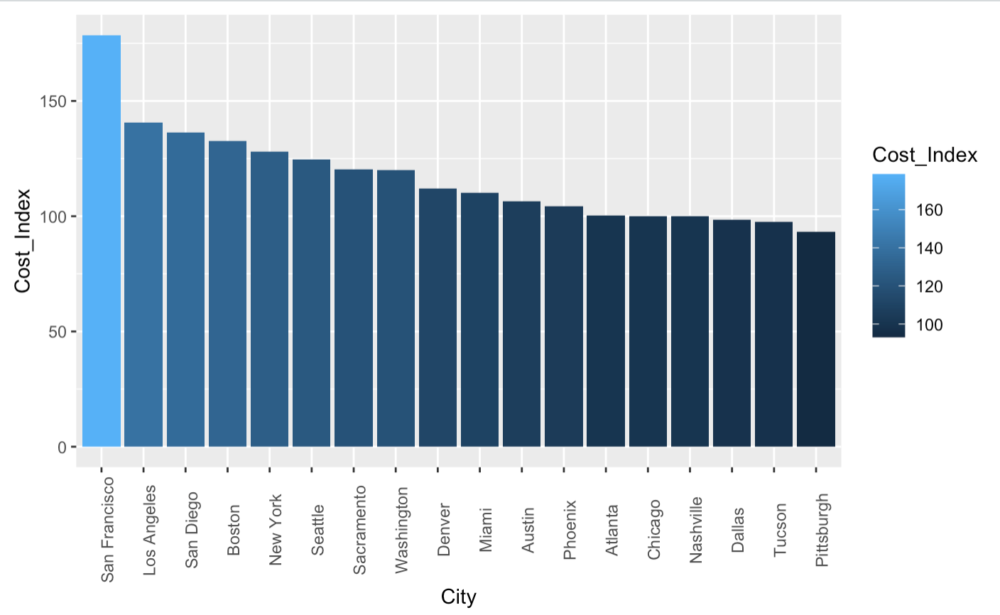
7. Cost of Living
Left graph shows the average price per drive in each cities. And New York charges the highest fare while Nashville charges the least.
Right graph shows cost index in each cities. San Francisco has the highest of cost of living and Pittsburg has the lowest

Slide 20
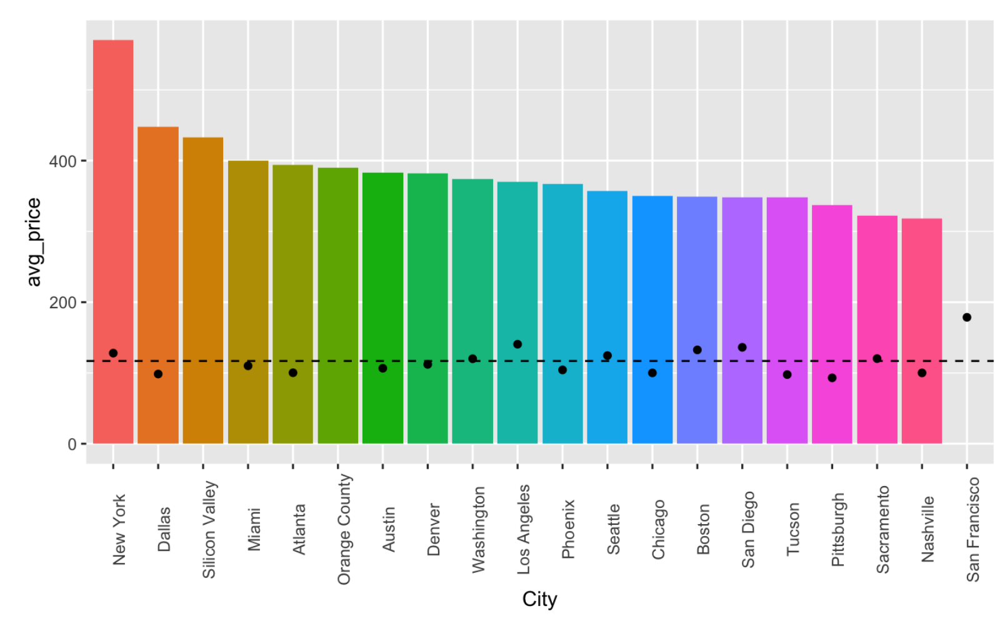
7. Cost of Living
- The line shows the average cost of living within all mentioned cities. - Some cities reflects the cost of living well while some cities do not.

Slide 21
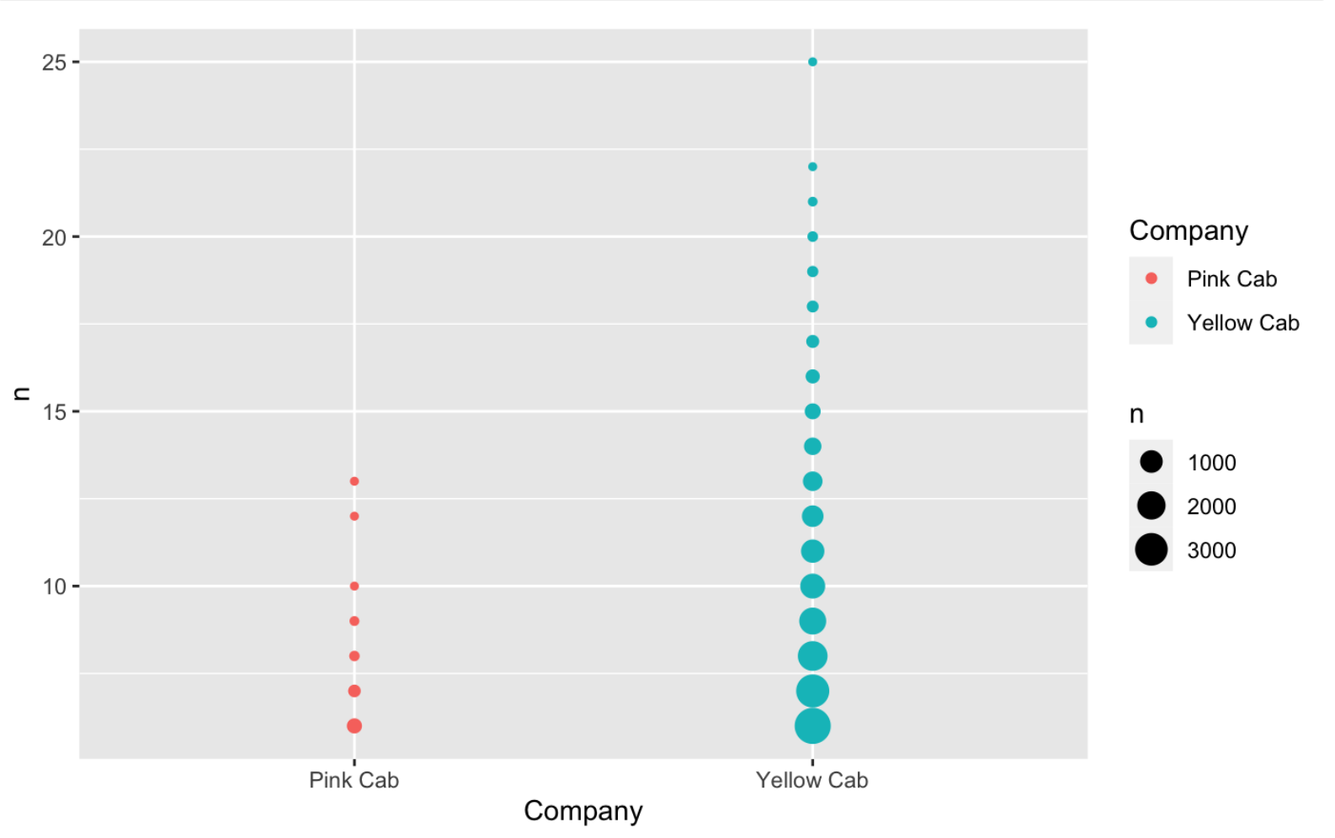
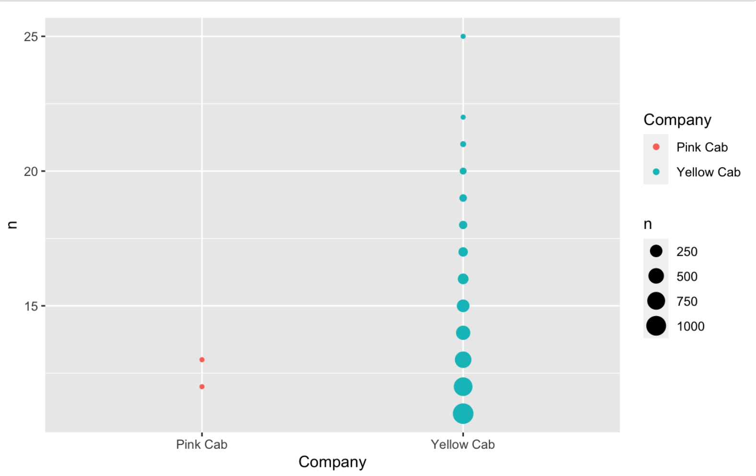
8. Regulars
Left shows the number of regulars who use more than 5 times within the same company.
Right shows the number of regulars who use more than 10 times within the same company.
Yellow Cab keeps regulars well compared to Pink Cab.

Slide 22
Summary
We found that Yellow Cab performs better than Pink Cab with below points. 1. All age groups prefers to take Yellow Cab than Pink Cab. 2. Yellow Cab take almost 3 times more profit compared to Pink Cab. 3. The most profitable cities, like New York, Chicago and Los Angeles, prefer to take Yellow cab than Pink Cab. 4. Yellow Cab keeps regulars better than Pink Cab. Based on this, we recommend to invest in Yellow Cab.

Slide 23
Suggestions
We can suggest the things below to increase the profit. 1. Payment Mode : Make an online payment or make sure to prepare the card reader devices well in the cab. 2. Customers with high income : Consider to make higher class of cab to attract customers with high income since they bring the profit the most. 3. Sunny days : Make a promotions or discount on sunny days to attract more customer. 4. Cities Preferences : Make sure not to lose customers on cities where bring a lot of profit, like New York, Chicago and Los Angeles. 5. Cost of living : Adjust the price which is reflects well the cost of living in different cities.

Slide 24
Thank You

